Slide 1
Software Development - SDLC

Slide 2

Software Development

Slide 3
Software Development
Software development:
programmer solve a problem
Now Systems are so big that everyone is involved on the creation.
From designers to customers working as a team.

Slide 4
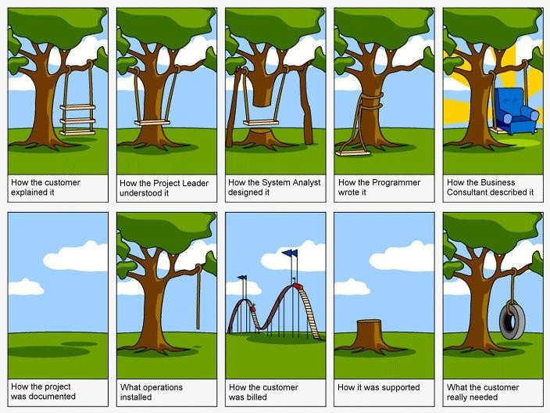
SQA - SDLC

Slide 5
Software Development
My goal is not to teach SDLC
The goal is to give you an overview of the pieces that goes into a software product.
Today highlights:
Major Components.
People and skills.
From Idea to final product.

Slide 6
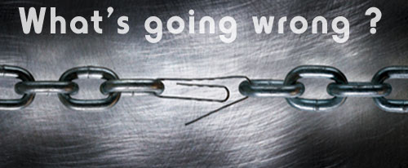
Software Development
What is a software product ?
A lot of pieces that goes into it.
Some of them are even ignored
As a software testers, you need to be aware of that.

Slide 7
Software Product
What efforts goes into a Software Product ?
What parts make up a Software Product ?
Software Product staff.
PM - PO
Architects
Developers
Conf Manager
Testers - QA
Tech writers

Slide 8
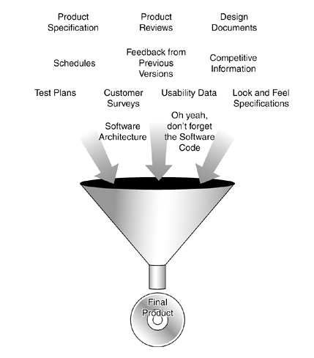
What efforts goes into a Software Product ?

Slide 9
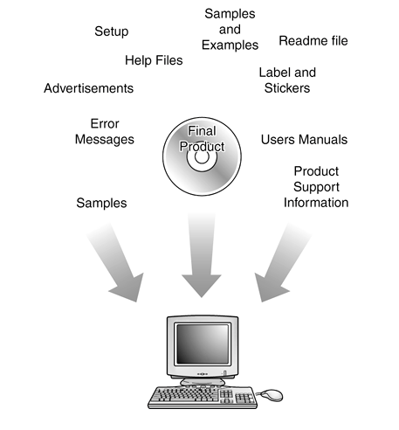
What parts make up a Software Product ?

Slide 10
SDLC - Models
There is a lot of models for software development
What they have in common:
Requirement gathering phase at the beginning
Maintenance phase after product is released
Primary activities (Phases)
Design
Develop
Deploy
Management

Slide 11
SDLC - Models
The linear or waterfall model
Rapid Application Development (RAD)
The prototyping model
The spiral model
build and fix
and synchronize-and-stabilize

Slide 12
SDLC - Models
Waterfall ( the old one)
use to be a synonymous of SDLC
Each phase is completed before next phase begin.
Water never flows upstream.
Analysis and design before development begins.
From Testing perspective offers a huge advantage.
Disadvantage is that test occurs at the end.

Slide 13
SDLC - Waterfall
Phases
Feasibility and Project planning (HL)
System analysis and definitions (Goals)
System design (Detail, screen layouts)
System Implementation (Real Code)
Integration and Testing
User Acceptance testing
Installation and Deployment (production)
Maintenance

Slide 14
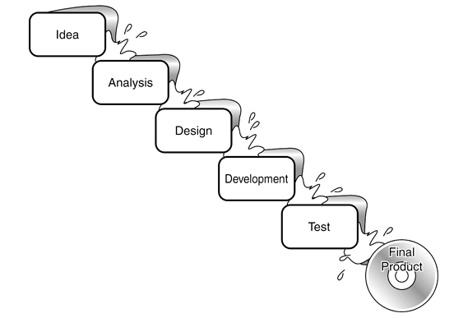
SDLC – Models - Waterfall

Slide 15
SDLC - Spiral
Spiral (Iteration)
Update to the waterfall model
Use the same phases
Design
Develop
Deploy
Manage
Main Idea is to not define everything in detail.
Define important features and try them out. (Start small)
Use prototyping and a prove of concepts
Get feedback and move to the next level.

Slide 16
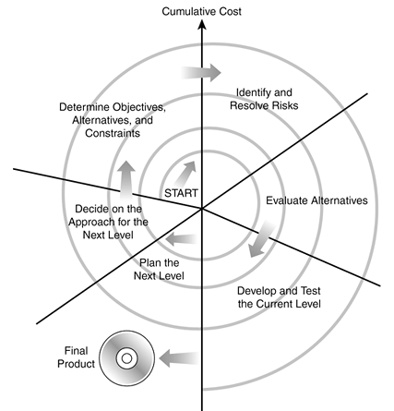
SDLC – Models - Spiral

Slide 17
SDLC - Spiral
Each Iteration is defined by 6 steps:
Determine objectives, alternatives and constraints
Identify and resolve risks
Evaluate alternatives
Develop and test the current level
Plan the next level
Decide on the approach for the next level
People find problems earlier.
As testers you influence the product from the beginning

Slide 18
SQA – Responsibilities for a Project
Typical SDLC phases and relevant Artifacts
SQA Responsibilities
Requirements Collection
Requirement Specs
Reviews
Analysis
Functional Specs
Reviews
Architecture & Design
Design Specs
Reviews
Development
Code & Executables
Implement
Test Cases
Testing
Deployment
Deployment Docs
Review

Slide 19
SQA Artifacts for a Project
Dev. Artifacts
SQA Artifacts
SQA Artifacts
(more)
Requirement Specs
RS Reviews
Functional Specs
FS Reviews
Test Plan
Design Specs
DS Reviews
Test Cases
Code & Executables
Bug Reports
More Test Cases
Deployment Docs
DD Reviews

Slide 20
Communication between SQA and Dev
Development
SQA
PM
Development
SQA

Slide 21
SQA – Software Quality Assurance
Quality Expectations
Must do the right things (Supposed to do)
Must do the things right (perform correctly)
SQE (Software Quality engineering)
Engineering Process
SQA
Inspection, defect prevention (Improves the process)
Software Testing
Behavior conform specifications
Demonstrate Software Quality

